Slide 1
Liver disease in childhood
Shaman Rajindrajith

Slide 2
Evaluation of a patient with liver dysfunction
Consider,
  Is liver disease present?
  If so what is it’s nature?
  What is its severity?
  Is specific treatment available?
  How can we monitor the response to treatment?
  What is the prognosis?

Slide 3
Manifestations of liver disease
Hepatomegaly
Jaundice
Pruritus
Spider naevi
Palmar erythema
Xanthomata
Portal hypertension
Ascites
Encephalopathy
Bleeding
Investigations
Serum Bilirubin
SGPT/SGOT
Serum albumin
Prothrombin time
γ Globulin
Serum Alkaline phosphatase
Serum Ammonia
Liver Biopsy
  Precise histology
  Enzyme analysis
  Analysis of stored material

Slide 4
Imaging in liver diseases
X-ray
Ultrasonography
CT Scan
MRI
Radio nuclear scanning
Cholangiography
ERCP

Slide 5
Hepatitis-A
Common in developing contries
Feco-oral transmission
Mild disease in children
Develop acute liver cell necrosis/mononuclear cell infiltration/preservation of liver architecture

Slide 6
Hep.A cont…
Clinical Picture
Fever, malaise, nausia, vomiting, anorexia
Jaundice follows
Duration less than 1month
No chronic liver disease
Prevention
Notification
Food hygiene
Active immunization
Passive immunization

Slide 7
Hepatitis - B
DNA virus replicating in liver
Modes of transmission
  Perinatal exposure
  Blood and blood products
  Sexual contact
Pathogenesis
  No cytopathic effects
  Immunological injury to hepatocytes

Slide 8
Clinical spectrum below 2 years
Sub clinical
Icteric hepatitis
Fulminent hepatitis
Acute hepatitis
2%
Chronic hepatitis
98%
Chronic active
hepatitis
Chronic persistent
hepatitis
Minimal
hepatitis

Slide 9
Clinical spectrum
above 2 years
Sub clinical
Icteric hepatitis
Fulminent hepatitis
Acute hepatitis
95%
Chronic hepatitis
5%
Chronic active
hepatitis
Chronic persistent
hepatitis
Minimal
hepatitis

Slide 10
Clinical picture
Acute/chronic hepatitis
Immunological phenomena
    Arthritis
    Serum sickness
    Skin rashes
    Glomerulonephritis
    Aplastic anaemia
Hepatomegaly
Splenomegaly
lymphadenopathy

Slide 11
Diagnosis
Hepatitis screen
Complications
Fulminent hepatic failure
Cirrhosis
Hepatocellular carcinoma
Management
Antiviral drugs

Slide 12
Hepatitis-C
RNA virus
Transfusion induced hepatitis
Sexual transmission is known
Causes
  chronic hepatitis
  Cirrhosis
  Hepatocellular carcinoma
Investigations
  HCV Ab, PCR

Slide 13
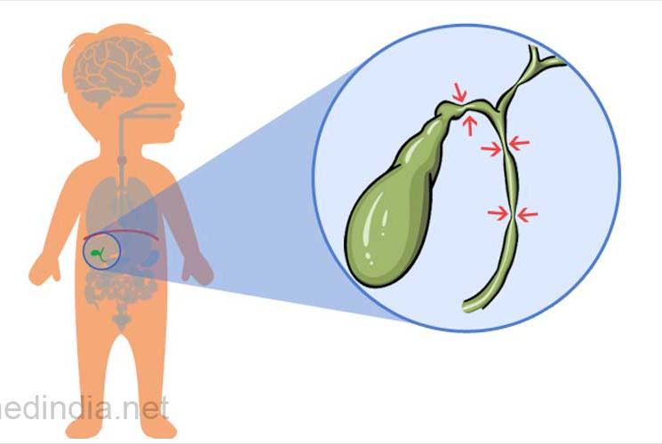
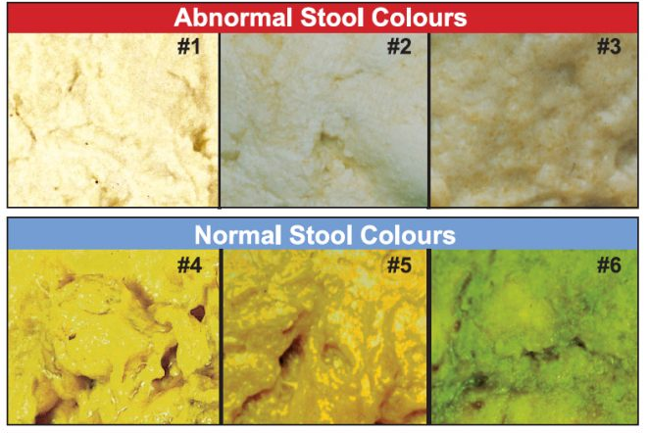
Biliary atresia
Presents with pale stools
Colour of the stools is the gold standard
Dark urine , jaundice will be present
Ultrasound scan
Cholangiography
Kasai portoenterostomy – to buy time
Liver transplantation

Slide 14
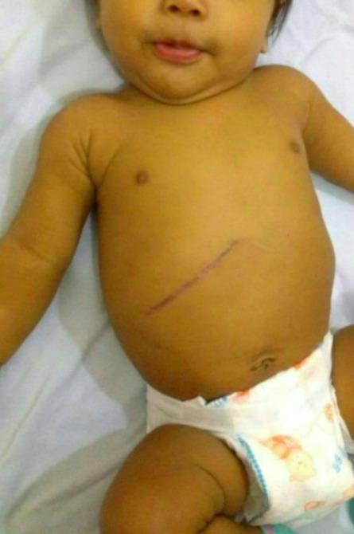
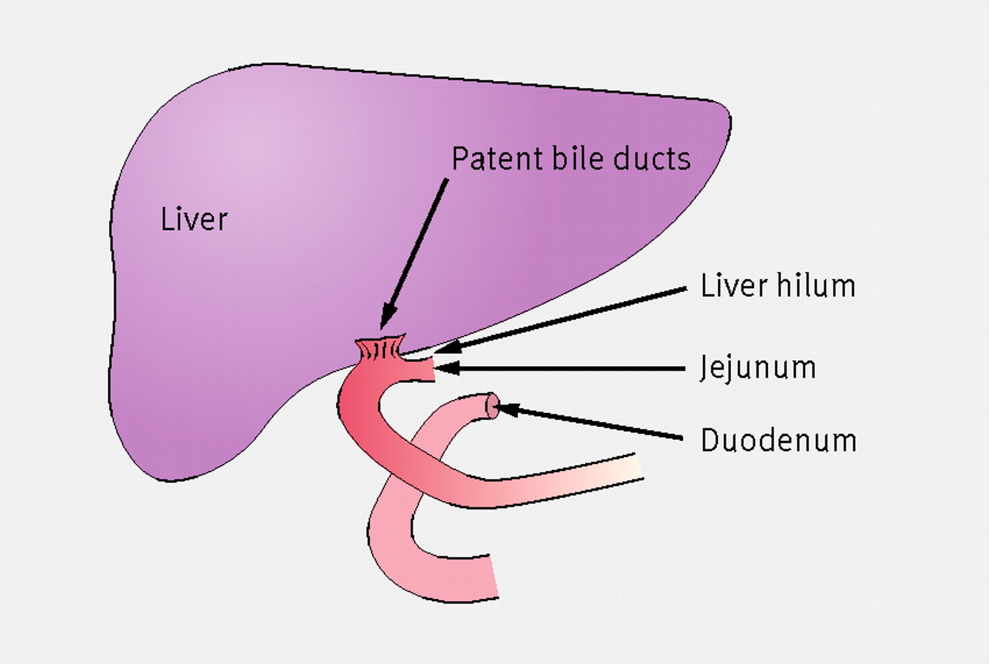
Kasai portoenterostomy for biliary atresia

Slide 15
Wilson Disease
Autosomal recessive disease
Abnormal copper transporting P-type ATPase
Chromosome 13q 14.3
Reduces copper excretion in to the bile
Finally copper accumulate in the liver, CNS, kidney.

Slide 16
Clinical Picture
Liver related
CNS related
Haemolytic diseases
Psychiatric manifestations

Slide 17
Liver Problems
Asymptomatic hepatomegaly
Acute hepatitis
Asymptomatic elevation of LFT
Liver failure
Jaundice
Cirrhosis

Slide 18
Neurological Problems
Usually in older age
Hypokinetic speech
Dystonia
Tremors
Incoordination
Kayser–Fleischer rings

Slide 19
Haemolytic anaemia
Due to excess copper release from hepatocytes
Induces haemolysis
Leads to anaemia and jaundice

Slide 20
Psychiatric disorders
Depression
Hallucinations
Irritability
Delusions
Poor school performances

Slide 21
Diagnostic tests
Serum Copper
Serum ceruloplasmin
24 hour urinary copper
Liver biopsy
KF rings
Genetics
Diagnostic index

Slide 22
Management
Main aims
  Reduce intestinal absorption
  Increase urinary excretion

Slide 23
Drugs
D-Penicillamine
Zn
Trientine
Tetrathiomolybdate

Slide 24
Other aspects
Liver transplant
Genetic counselling
Carrier detection

Slide 25
FULMINANT HEPATIC FAILURE

Slide 26
Definition
  Clinical syndrome resulting from massive necrosis of hepatocytes or from severe functional impairment of hepatocytes in a patient who does not have pre-exciting liver disease over a period of 8 weeks.

Slide 27
Aetiology
Viral Hepatitis (A,B,D,E)
  Other viruses
  Hepatotoxic drugs (paracetamol,valproate….)
  Circulatory shock
  Metabolic disorders
Why Encepholopathy?
    Increase ammonia
    False neurotransmitters
    Increase GABA
    Increase benzodiazepines

Slide 28
Clinical features
Previously healthy child
Fever
Vomiting
Abdominal pain
Progressive jaundice
Fetor hepaticus
Rapidly reducing liver size
Haemorrhagic diathesis
ascites

Slide 29
Hepatic encephalopathy
Minor disturbances in consciousness or motor function.
Irritability
Poor feeding
Change in sleep rhythm
Asterixis
Somnolence
Combativeness
Confusion
Gradually progress to coma with
  decerebrate rigidity
  Increased planters

Slide 30
Investigations
Increased serum bilirubin
Increased SGPT / SGOT
Increased ammonia
Prolonged prothrombin time
Electrolyte imbalances
Metabolic acidosis

Slide 31
TREATMENT
Arterial line/Venous line
N.G.Tube
Catheter
Maintain systemic BP to keep adequate cerebral perfusion
I.V.Fluids
  10%dextrose /electrolytes solution
  2/3 of normal requirement

Slide 32
TREATMENT cont..
TO reduce ICP
  Manitol
  IPPV with hyperventilation
Vitamin K
FFP
Lactulose and neomycin
Cimitidine

Slide 33
Chronic liver disease
Impairment of liver functions lasting more than 3 months
Low albumin and presence of portal hypertension are characteristic
Might lead to sudden decompensation with infections or GI bleeding
Ultimately require transplantation

Slide 34
Management of chronic liver disease
Supportive
-Correct the coagulopathy : FFP/ PCC
-Correct the hypoalbunaemia : Albumin transfusions
-Therapeutic paracentesis
-Decontamination of the bowel if encephalopathy
-Avoid precipitating factors of encephalopathy
-Monitor for hepato-renal syndrome and hepato- pulmonary syndrome
-Nutritional rehabilitation
-Management of portal hypertension
Treat the specific underlying cause

Slide 35


